Slide 1
APA County Planning Division
National Association of County Planners
Award of Excellence
Small Area/Special Area Planning
Elizabeth Area Plan
Charlotte-Mecklenburg Planning Department

Slide 2
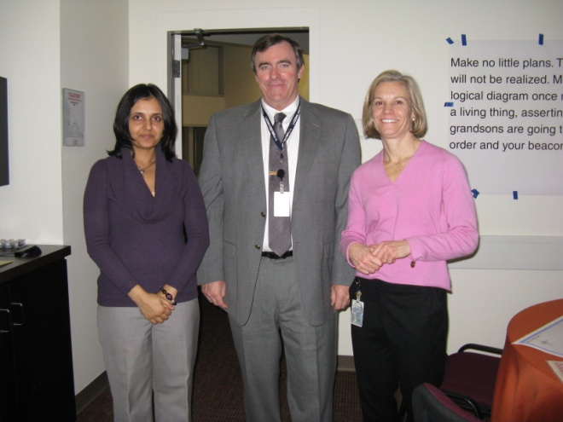
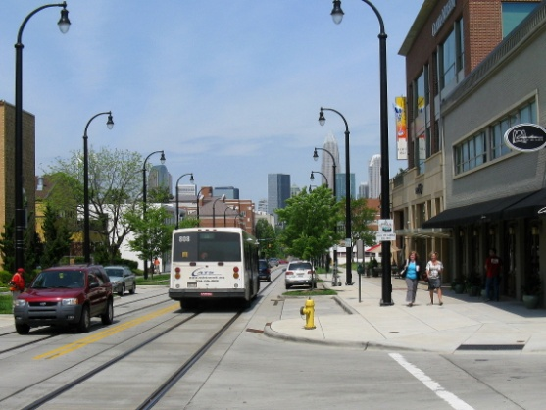
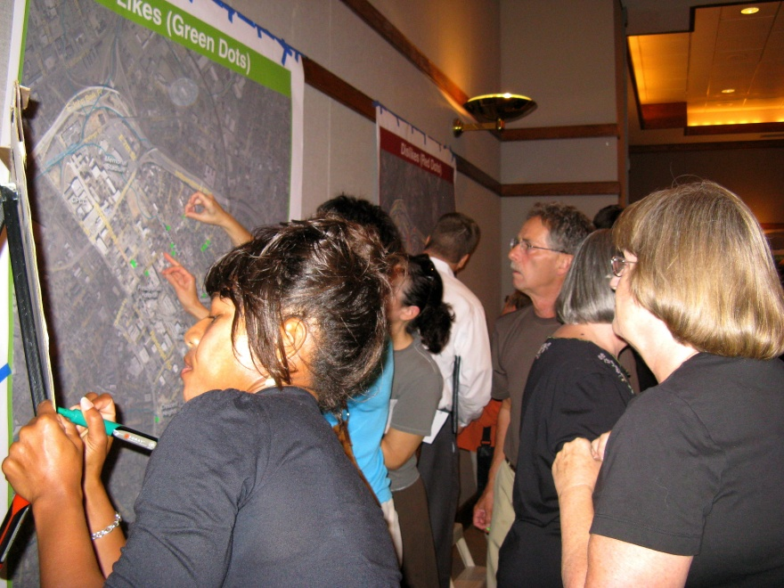
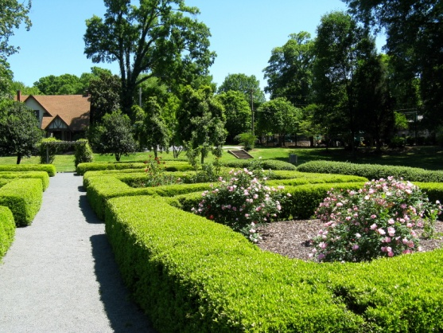
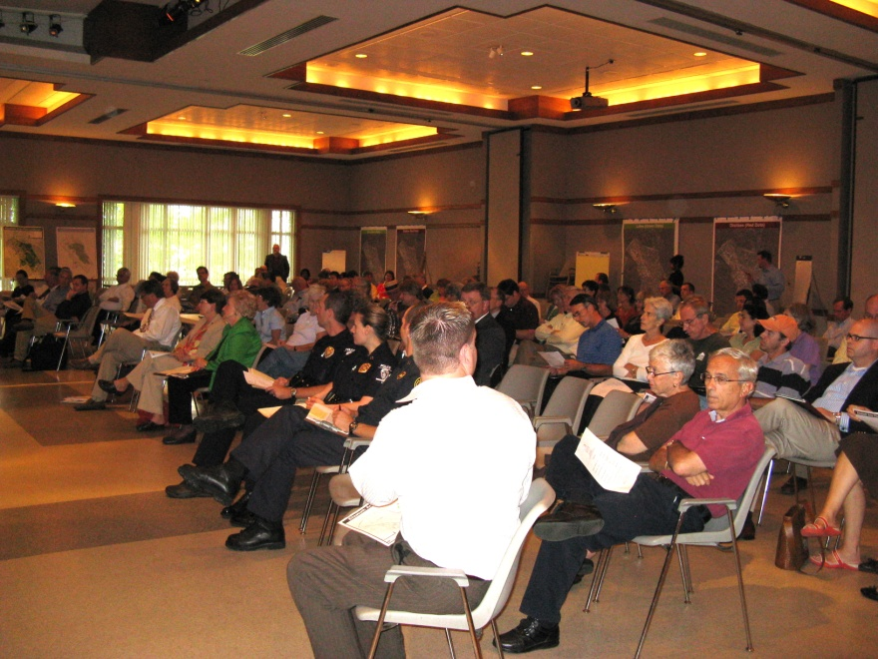
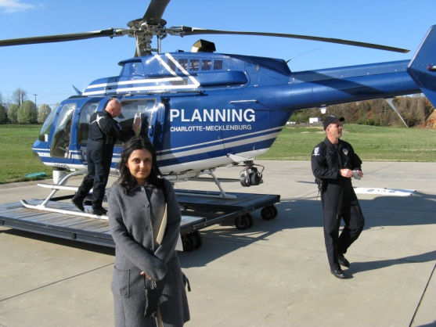
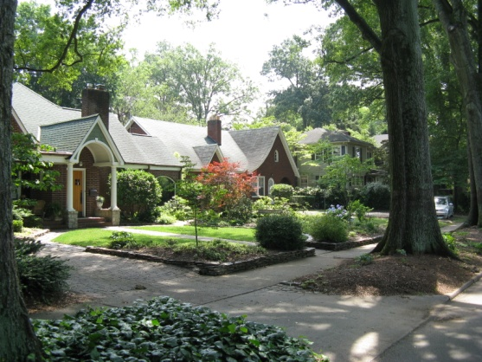
Elizabeth Area Plan
Innovation
Transferability
Quality
Implementation
Comprehensiveness

Slide 3
Innovation
Intensive Stakeholder Involvement
Meeting #11
November 17, 2010
Meeting #7
April 7, 2010
Land Use
Meeting #6
March 3, 2010
Community Design
Meeting #8
May 5, 2010
Land Use
Transportation Concepts
A schedule like this was shown at each meeting so that stakeholders always knew where we were in the plan development process.
Final Public Meeting
May 17, 2011
Present Draft Area Plan
Meeting #10
October 20, 2010
Land Use, Streetscape, Transit Station Area, PED
Meeting #5
Feb. 3, 2010
Land Use
Mid-Point Public Meeting
June 9, 2010
Progress Report &
Preliminary Transportation Analysis
Meeting #9
June 23, 2010
7th Street Land Use & Transportation
Kickoff Meeting
September 22, 2009
Meeting #12
June 15, 2011
Meeting #4
Jan. 6, 2010
Parks/Open Space
Greenways
Environment
Meeting #1
Oct. 14, 2009
Introduction
Issue Identification
Vision Statement
Meeting #3
Dec. 2, 2009
Plan Process Issues
Transit Corridor Update
Transportation Issues and Analysis
Meeting #2
Nov. 4, 2009
Vision Statement
Introduction to Land Use
Plan
Adoption
Process

Slide 4
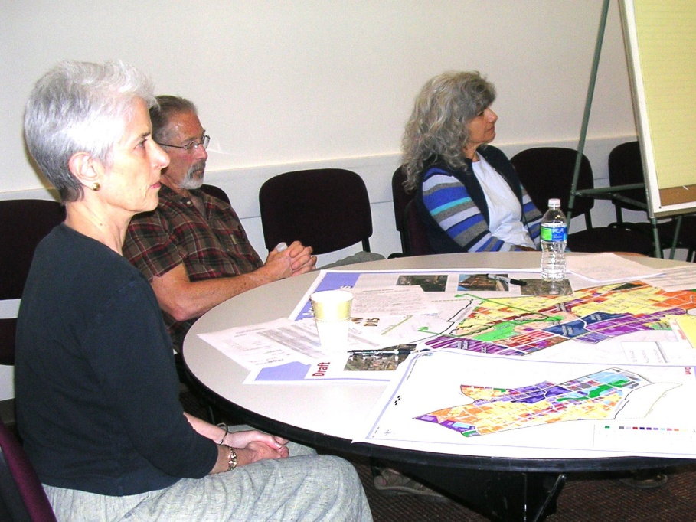
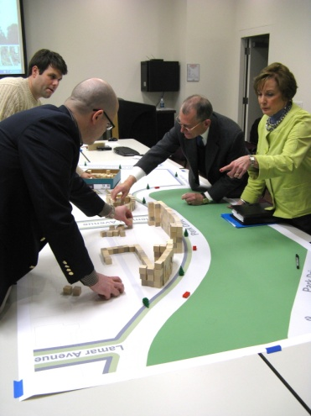
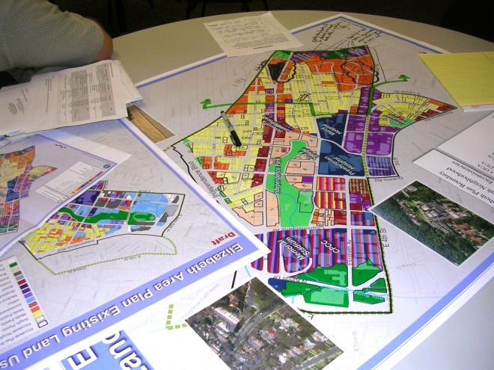
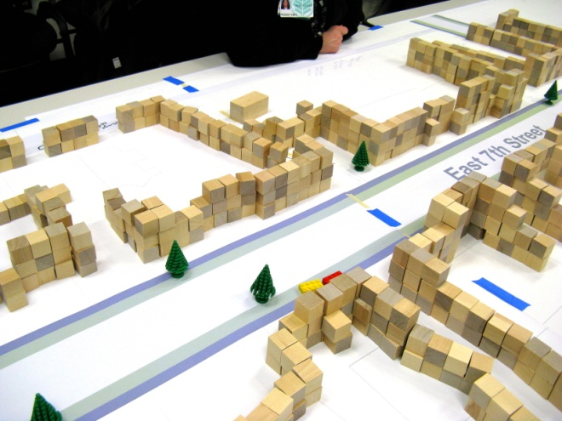
Innovation
Intensive Stakeholder Involvement
CAG Meetings
Stakeholders had a hands-on
role in plan development

Slide 5
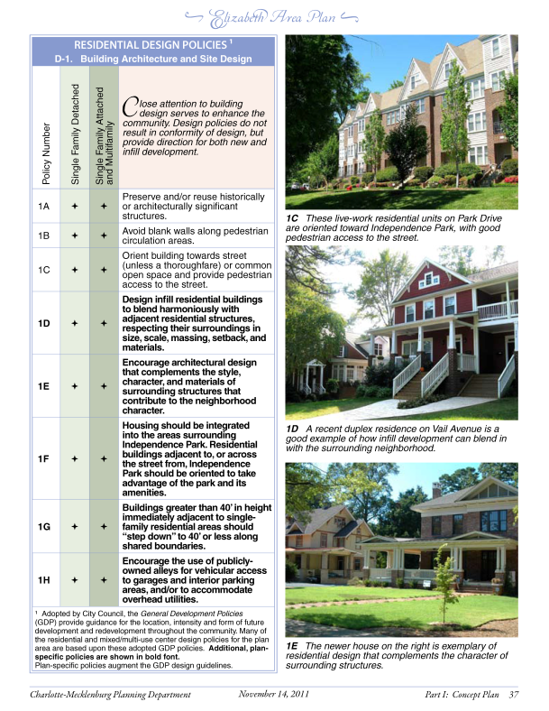
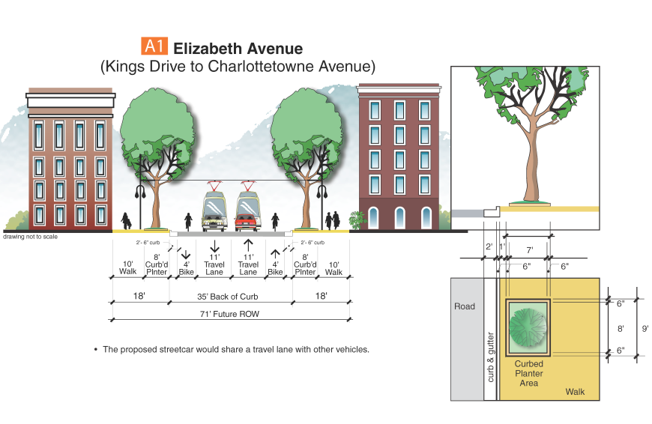
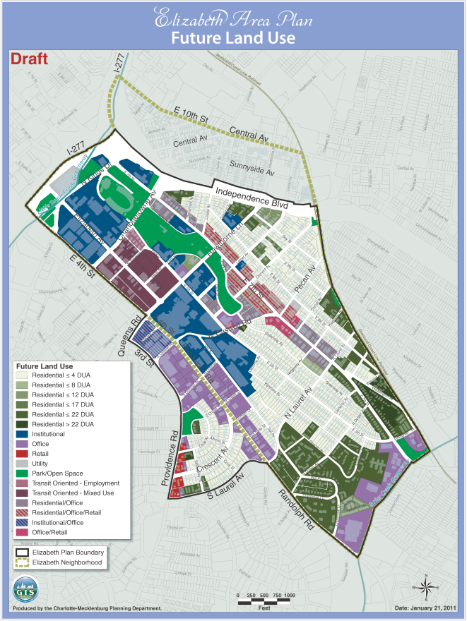
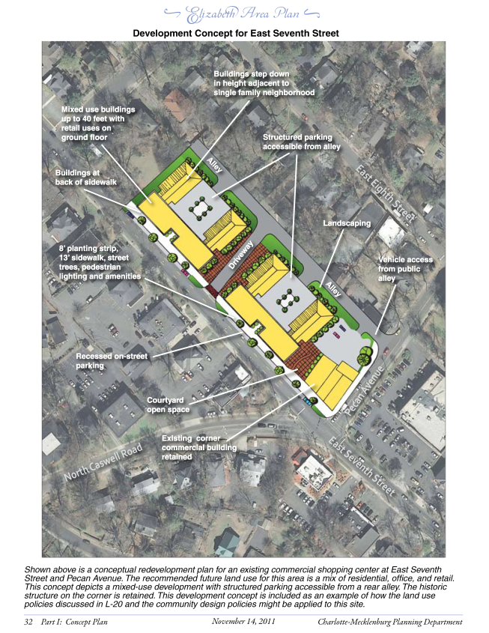
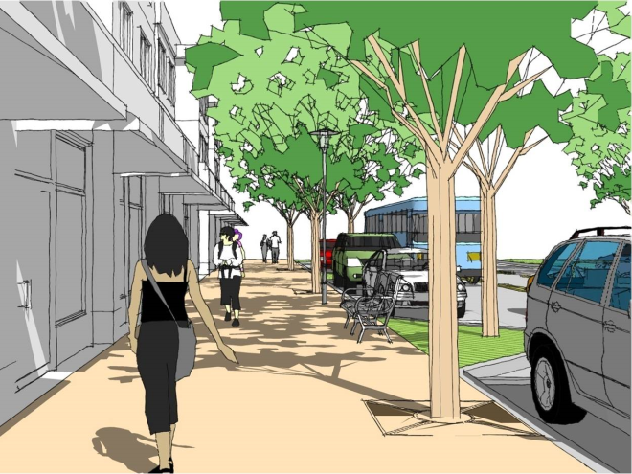
Innovation
Area Plan as a Clearinghouse for Policies
Streetscape
Cross-Sections
Future Land Use
Design Guidelines
Development Concepts

Slide 6
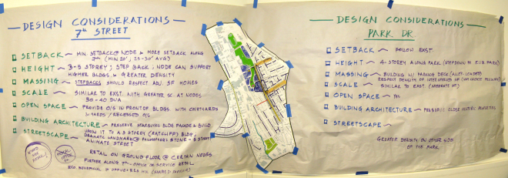
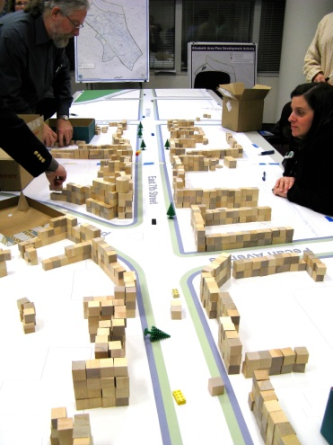
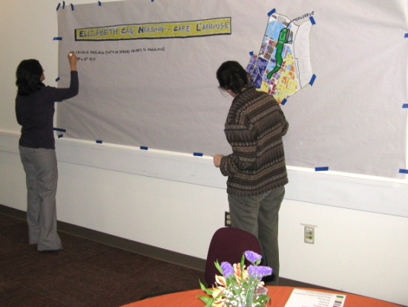
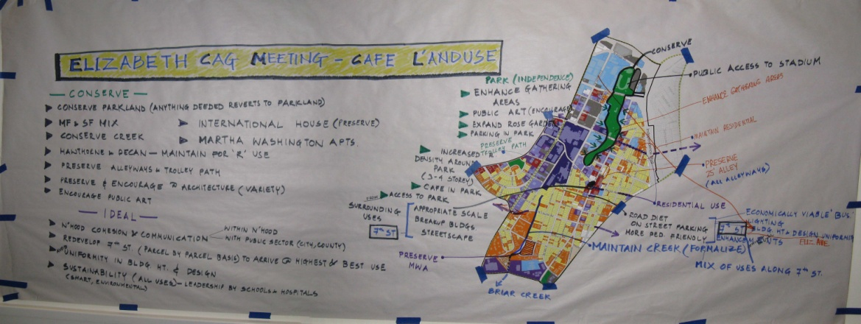
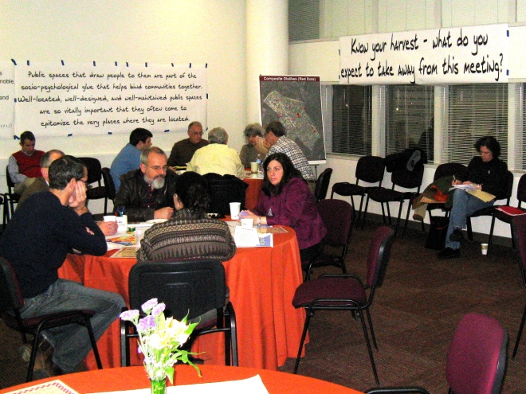
Transferability
The World Café and building block meeting formats can be employed effectively to work through a variety of issues and processes.

Slide 7
Quality
The plan provides a thorough analysis of the plan area’s:
Opportunities
Challenges
Goals
Community Vision
Succinct direction for:
Land Use
Community Design
Transportation
Public Facilities
Environmental Policies
Land Use and Community Design Vision “Centerfold”

Slide 8
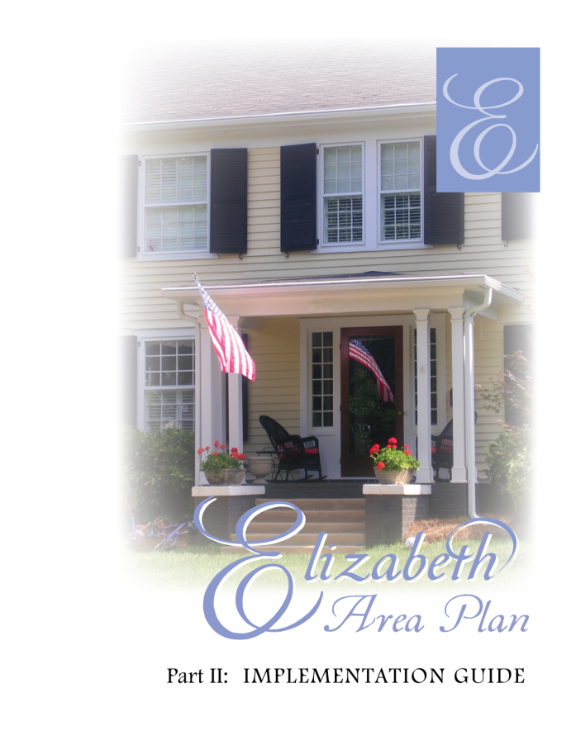
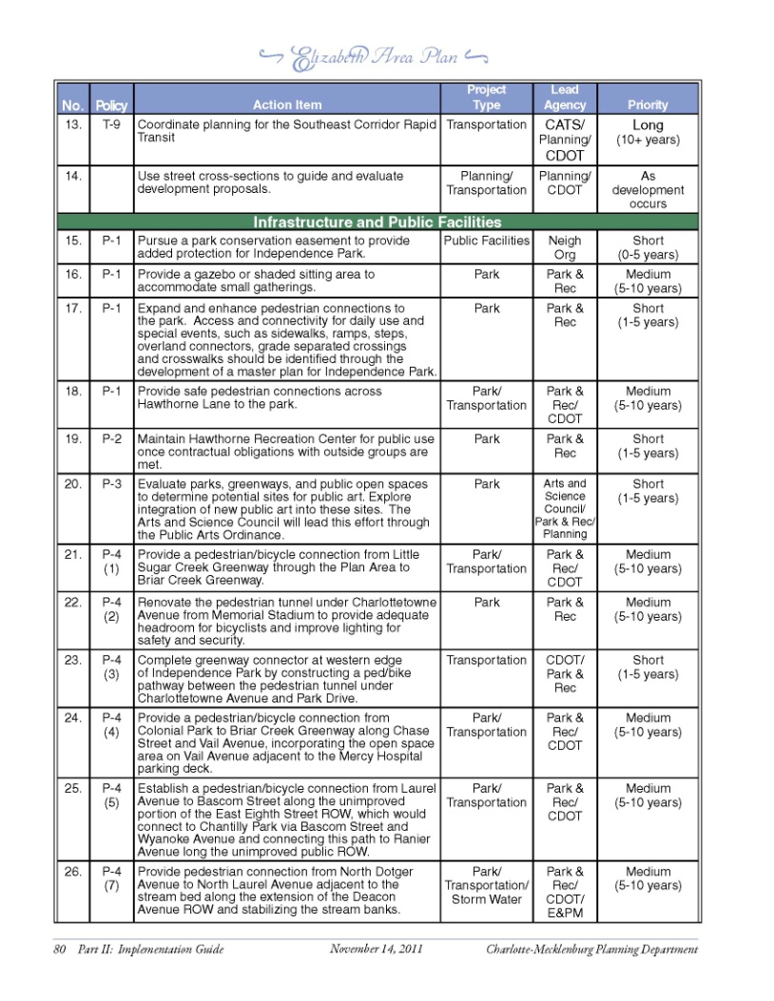
Implementation
The plan includes a menu of strategies and action items that implement area plan policies and recommendations.
These include capital projects as well as organizational strategies and possible changes to existing City policies or regulations.

Slide 9
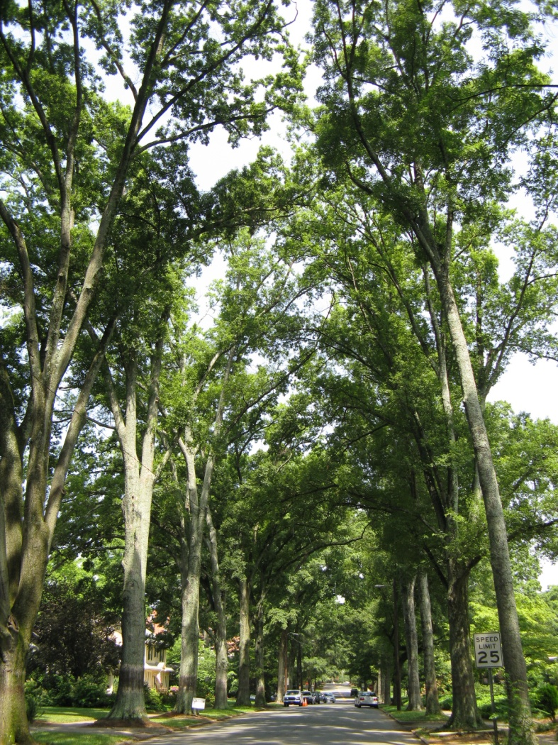
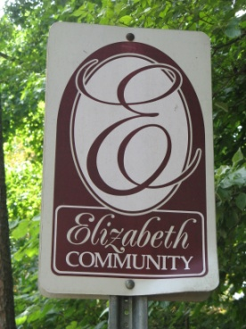
Comprehensiveness
Besides establishing a vision for the plan area and providing policy direction to guide future growth, the Elizabeth Area Plan also:
Updates existing adopted plans
Refines boundaries identified in City’s growth framework
Addresses key issues identified through the planning process
Provides guidance for future land use and infrastructure decisions
Functions as the official streetscape plan

Slide 10
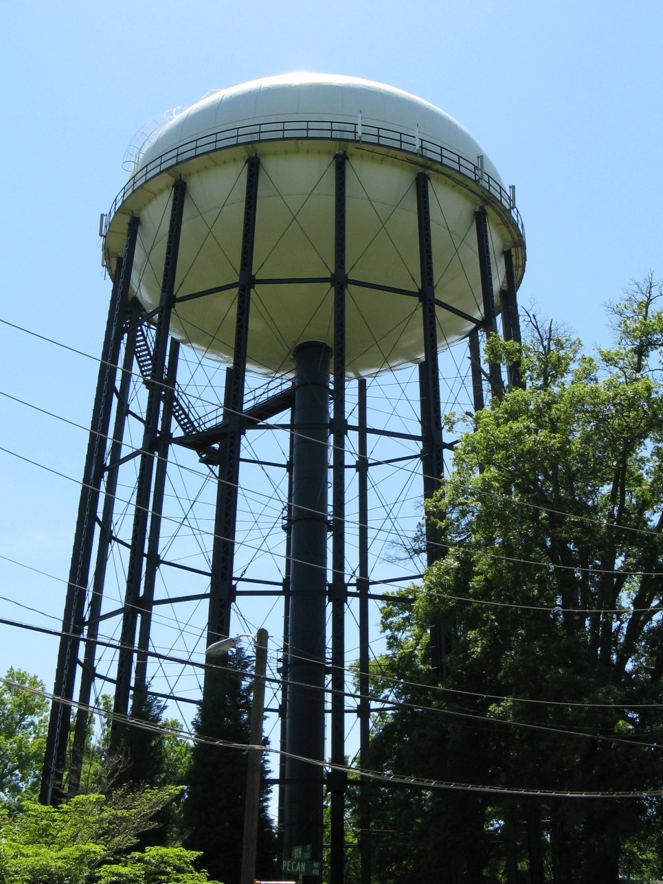
Thank You
Charlotte-Mecklenburg Planning Department
CharlottePlanning.org

